Slide 1
SS8H4a
Georgia’s
Constitution
Articles of
Confederation
and the
© 2014 Brain Wrinkles

Slide 2
Georgia Constitution
Georgia’s provincial congress met after the Declaration of Independence was adopted to create a new government.
In 1777, a new state constitution was implemented that defined separate executive, legislative, and judicial branches.
The constitution also listed basic rights, outlined election process for governor (one-year term) and other state officials, created a superior court for each county, and gave the state’s power to the unicameral legislature.
© 2014 Brain Wrinkles

Slide 3
Georgia Constitution
The Georgia Constitution of 1777 did a good job of separating the government branches and protecting basic rights of the citizens.
However, it put too much power in the hands of the legislature.
Also, the legislature was unicameral so there was no check on its power.
Georgia’s constitution was not ratified by a vote from its people, so it did not fully represent their interests.
© 2014 Brain Wrinkles

Slide 4
Articles of Confederation
America’s first written constitution was not the Constitution that we have in place today.
After the Revolutionary War ended, Congress began writing the Articles of Confederation with a strong central government in mind.
Many states opposed this because they did not want a monarchy and their goal was to give as much power as possible “to the people”.
© 2014 Brain Wrinkles

Slide 5
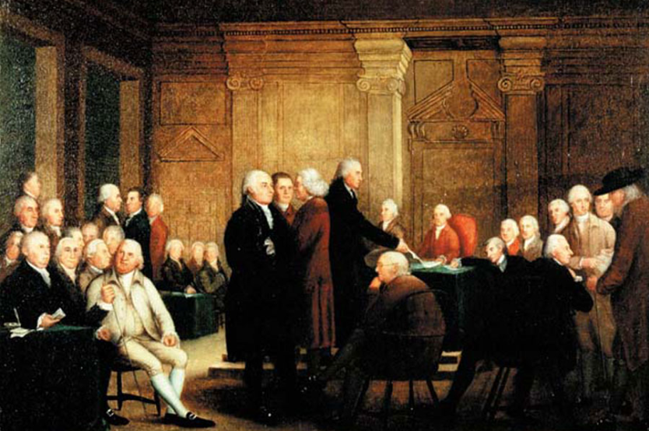
Drafting the Articles of Confederation
© 2014 Brain Wrinkles

Slide 6
Articles of Confederation
The Articles of Confederation went into effect on March 1, 1781.
The Articles set up a republican democracy where citizens elect people to represent them.
Unfortunately, the Articles created an extremely weak central government that gave states a lot of power over their own affairs.
© 2014 Brain Wrinkles

Slide 7
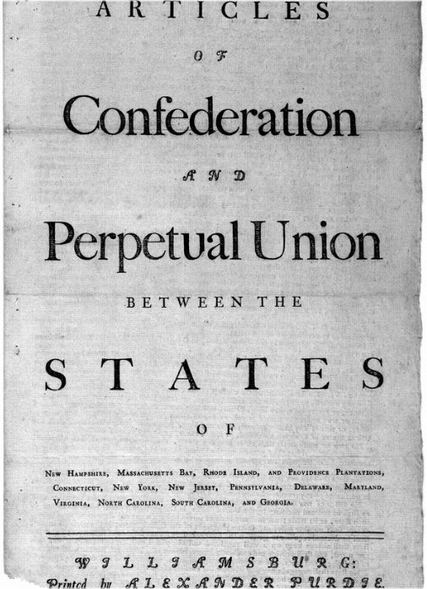
© 2014 Brain Wrinkles

Slide 8
Weaknesses
The Articles could not levy taxes to fund the government (making it impossible to pay debts or soldiers).
It could not regulate trade among the states (could put tariffs on each other).
It provided for no judicial or executive branch, only a legislative branch.
© 2014 Brain Wrinkles

Slide 9
Weaknesses
Congress could make laws, but not force states to comply with them.
Each state only received 1 vote, regardless of its population.
All 13 states had to approve a law for it to pass.
Each state had its own currency.
© 2014 Brain Wrinkles

Slide 10
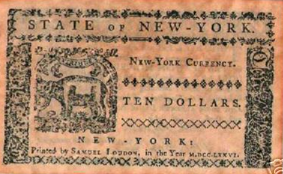
The United States did not have a common currency under the Articles of Confederation.
© 2014 Brain Wrinkles

Slide 11
Time for Change
It soon became apparent that the Articles had to be revised.
The states argued over borders and trade, and Congress had no power to stop them.
Foreign governments did not know if they were dealing with 1 country or 13 different ones.
The country’s economy worsened.
© 2014 Brain Wrinkles

Slide 12
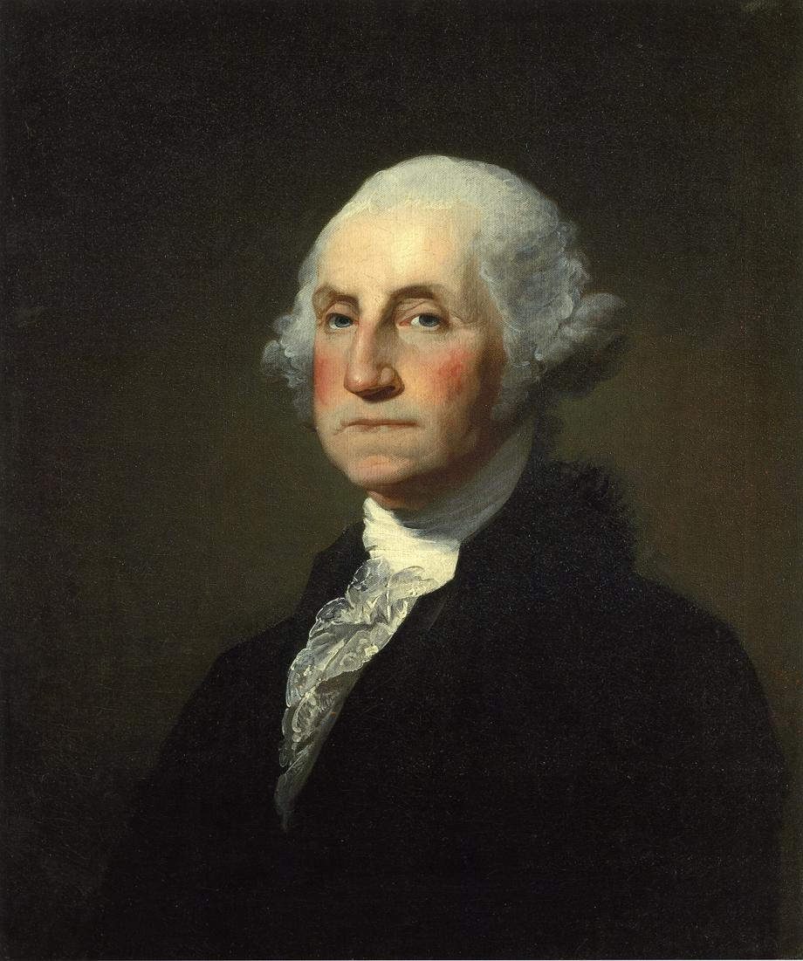
George Washington called the Articles of Confederation “a half-starved, limping government”.
© 2014 Brain Wrinkles

Slide 13
SS8H4b
Constitutional
Convention
Ratification of the
New Constitution
© 2014 Brain Wrinkles

Slide 14
Convention
The founders realized that the Articles of Confederation were too weak to effectively govern the country and had to be revised.
In May 1787, delegates from all 13 states met in Philadelphia with the intent to change the Articles.
The members ended up discarding the Articles and writing a completely new document.
This meeting became known as the Constitutional Convention.
© 2014 Brain Wrinkles

Slide 15
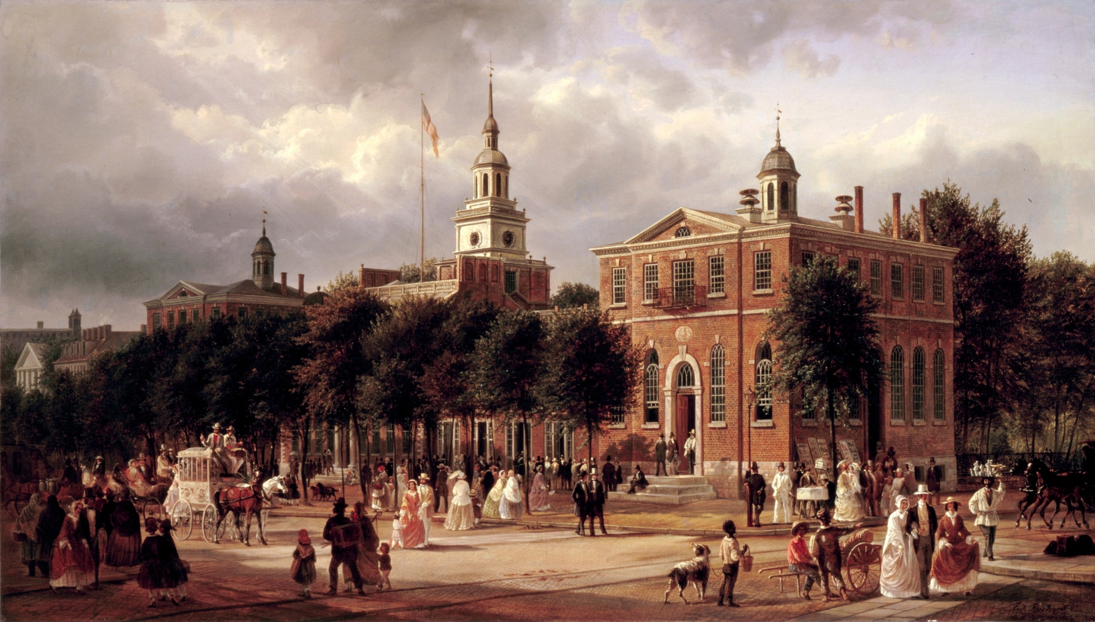
Independence Hall, Philadelphia
© 2014 Brain Wrinkles

Slide 16
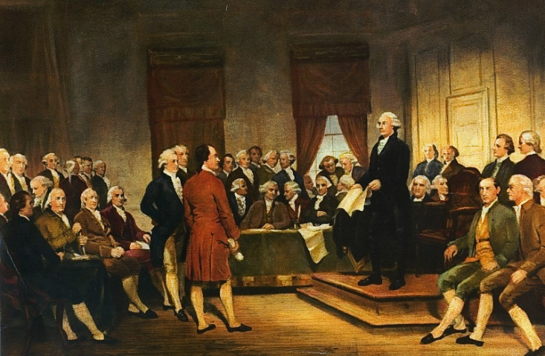
Constitutional Convention
1787
© 2014 Brain Wrinkles

Slide 17
Abraham Baldwin
Georgia had two delegates that signed the Constitution, Abraham Baldwin and William Few.
Abraham Baldwin was a native of Connecticut and a graduate of Yale University.
During the American Revolution, he served as a chaplain in the U.S. Army.
In 1784, he moved to Georgia and became a successful politician.
© 2014 Brain Wrinkles

Slide 18
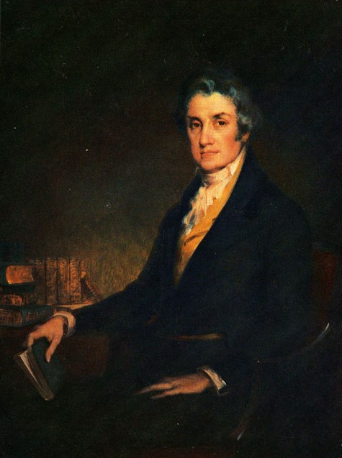
Abraham Baldwin
© 2014 Brain Wrinkles

Slide 19
Representation
During the Constitutional Convention, Baldwin was involved in debates over the issue of representation.
With the Virginia Plan, small states were worried that they would be outnumbered by large states.
Baldwin changed his vote to side with the smaller states, and his vote forced a tie.
© 2014 Brain Wrinkles

Slide 20
Great Compromise
To solve the representation issue, Baldwin helped develop the Great Compromise.
This created a bicameral legislature where each state had two members in the Senate, but representation in the House of Representatives was based on the state’s population.
The compromise pulled the convention out of a complete deadlock.
© 2014 Brain Wrinkles

Slide 21
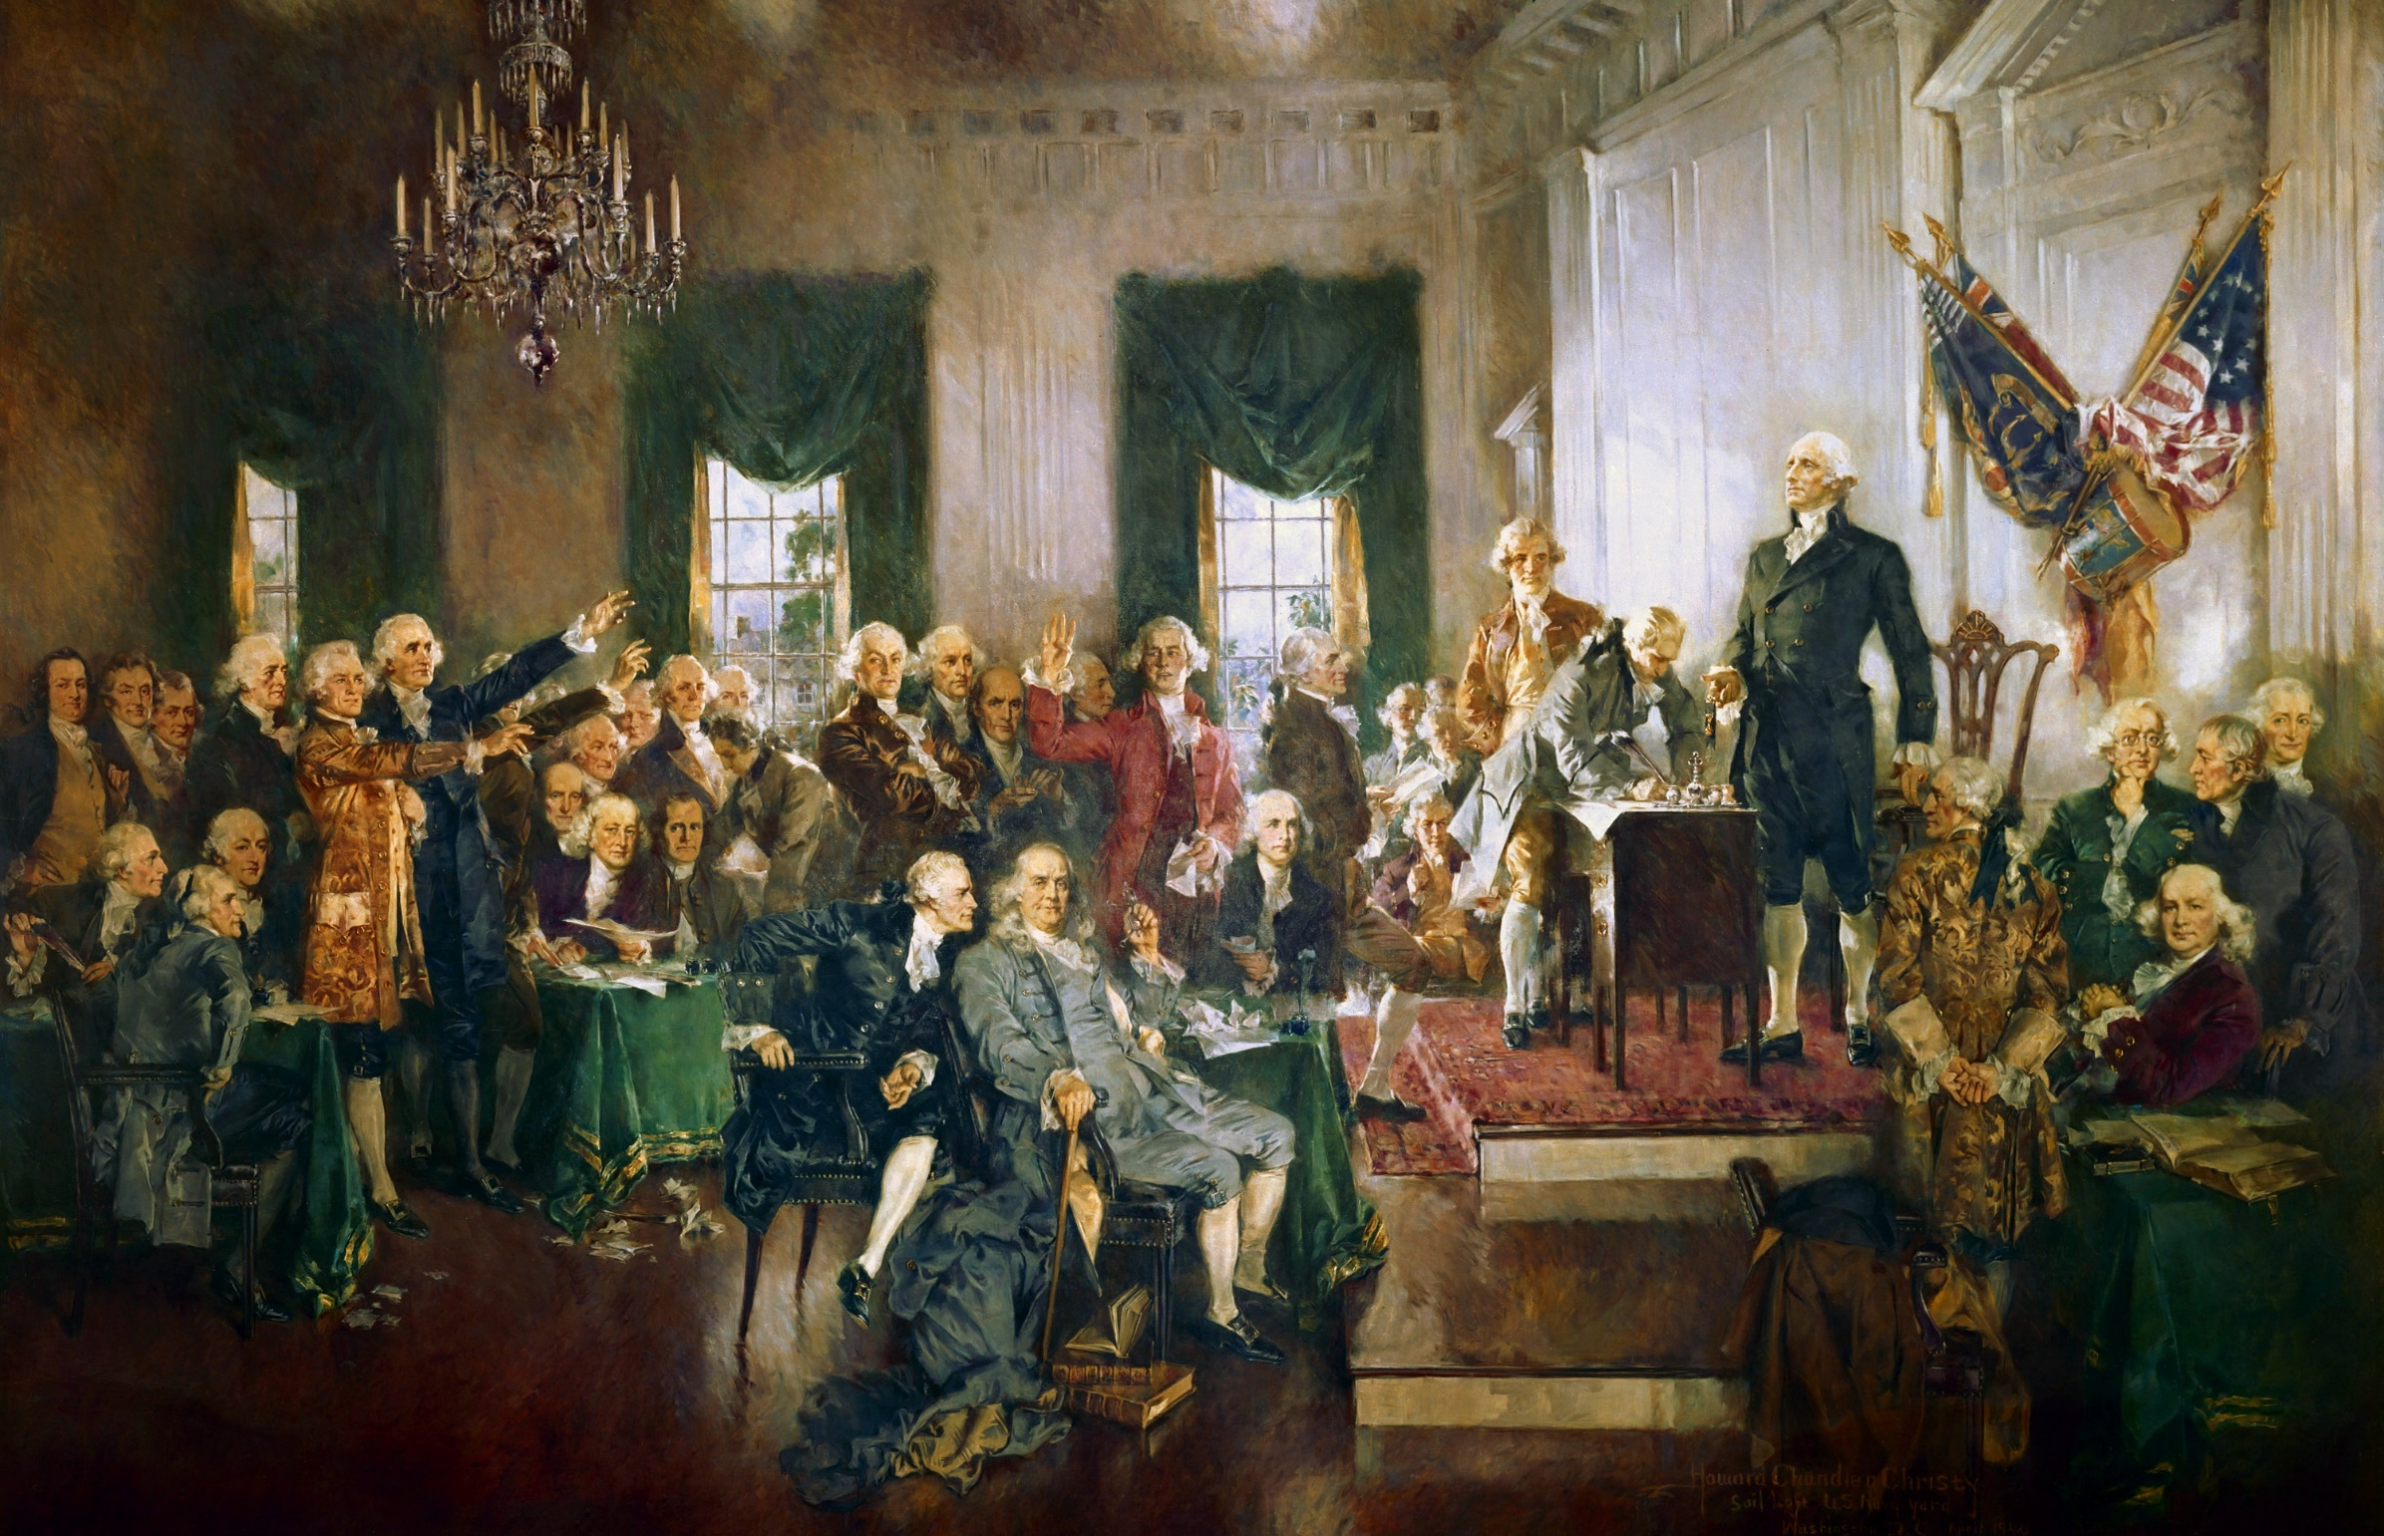
© 2014 Brain Wrinkles

Slide 22
William Few
In 1787, most Georgians supported a strong central government.
Georgia’s other delegate to the convention, William Few, represented Georgians well by voting in favor of the national government during critical times at the convention.
He worked diligently to make sure that the Constitution was ratified.
© 2014 Brain Wrinkles

Slide 23
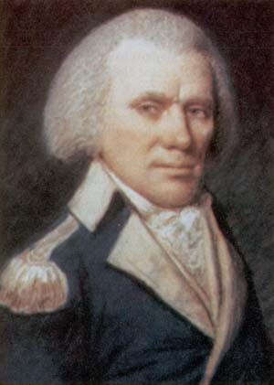
William Few
© 2014 Brain Wrinkles

Slide 24
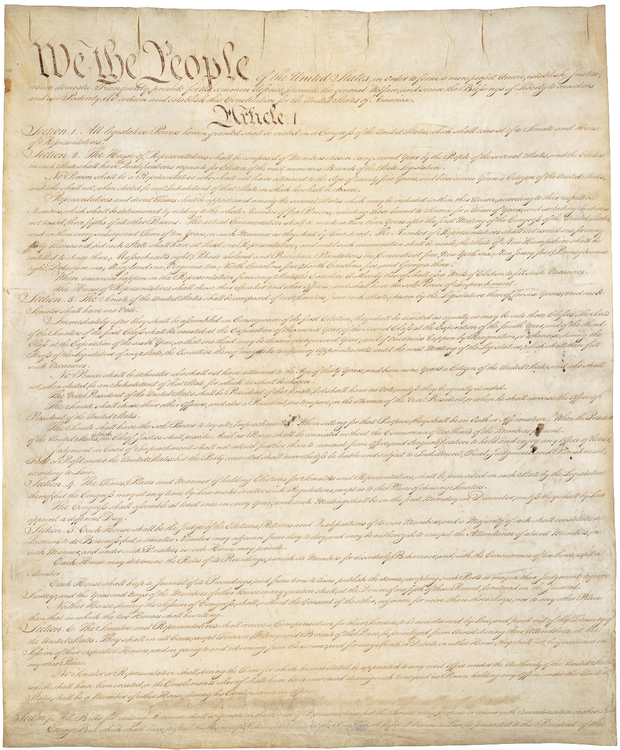
Page 1 of the Original Copy of the U.S. Constitution
© 2014 Brain Wrinkles

Slide 25
Georgia
On January 2, 1788, Georgia was the 4th state to ratify the U.S. Constitution.
Many Georgians favored a strong national government that could protect them from Native Americans and the Spanish in Florida.
Georgians in coastal regions also hoped that the central government would improve trade regulations.
© 2014 Brain Wrinkles

